Slide 1
Code Review

Slide 2
Code is a liability
Maintenance task for someone else
Duplicated code is not only wasted effort but cost more in time
“If you’re writing it from scratch, you’re doing it wrong”

Slide 3
3 Aspects of Reviews
Correctness and comprehension check - code does what the author claims it does
Approval from code owners
Approval from someone with language “readability”
Notes:
Readability = 4 spaces or 2 spaces in js, etc.

Slide 4


Readability

Slide 5
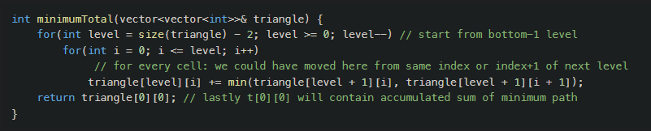
Readability

Slide 6
Code Review Benefits
Checks code correctness
Ensure the code change is comprehensible to other engineers
Enforce consistency across the codebase
Psychologically promotes team ownership
Enables knowledge sharing
Provides a historical record of the code review itself

Slide 7
Code Review Best Practices
Be polite and professional
Write small changes
Write good change descriptions – what & why
Keep reviewers to a minimum
Automate when possible
Notes:
Small should be ~ 200 lines of code & easy for a reviewer to digest – also leads to faster approvals
Description “bug fix” is not helpful for future code archeologist – include what is being changed and why
Most code reviews at google are reviewed by 1 reviewer
Automation include pre-commit linters & sonar

Slide 8
4 Types of Code Reviews
Greenfield reviews & new feature development
Behavioral changes, improvements, and optimization
Bug fixes & rollbacks
Refactorings & large-scale changes

Slide 9
Greenfield Reviews
Will it be easier to maintain as time and scale changes the underlying assumptions?
Tests that fail when assumptions change
Sufficiently commented

Slide 10
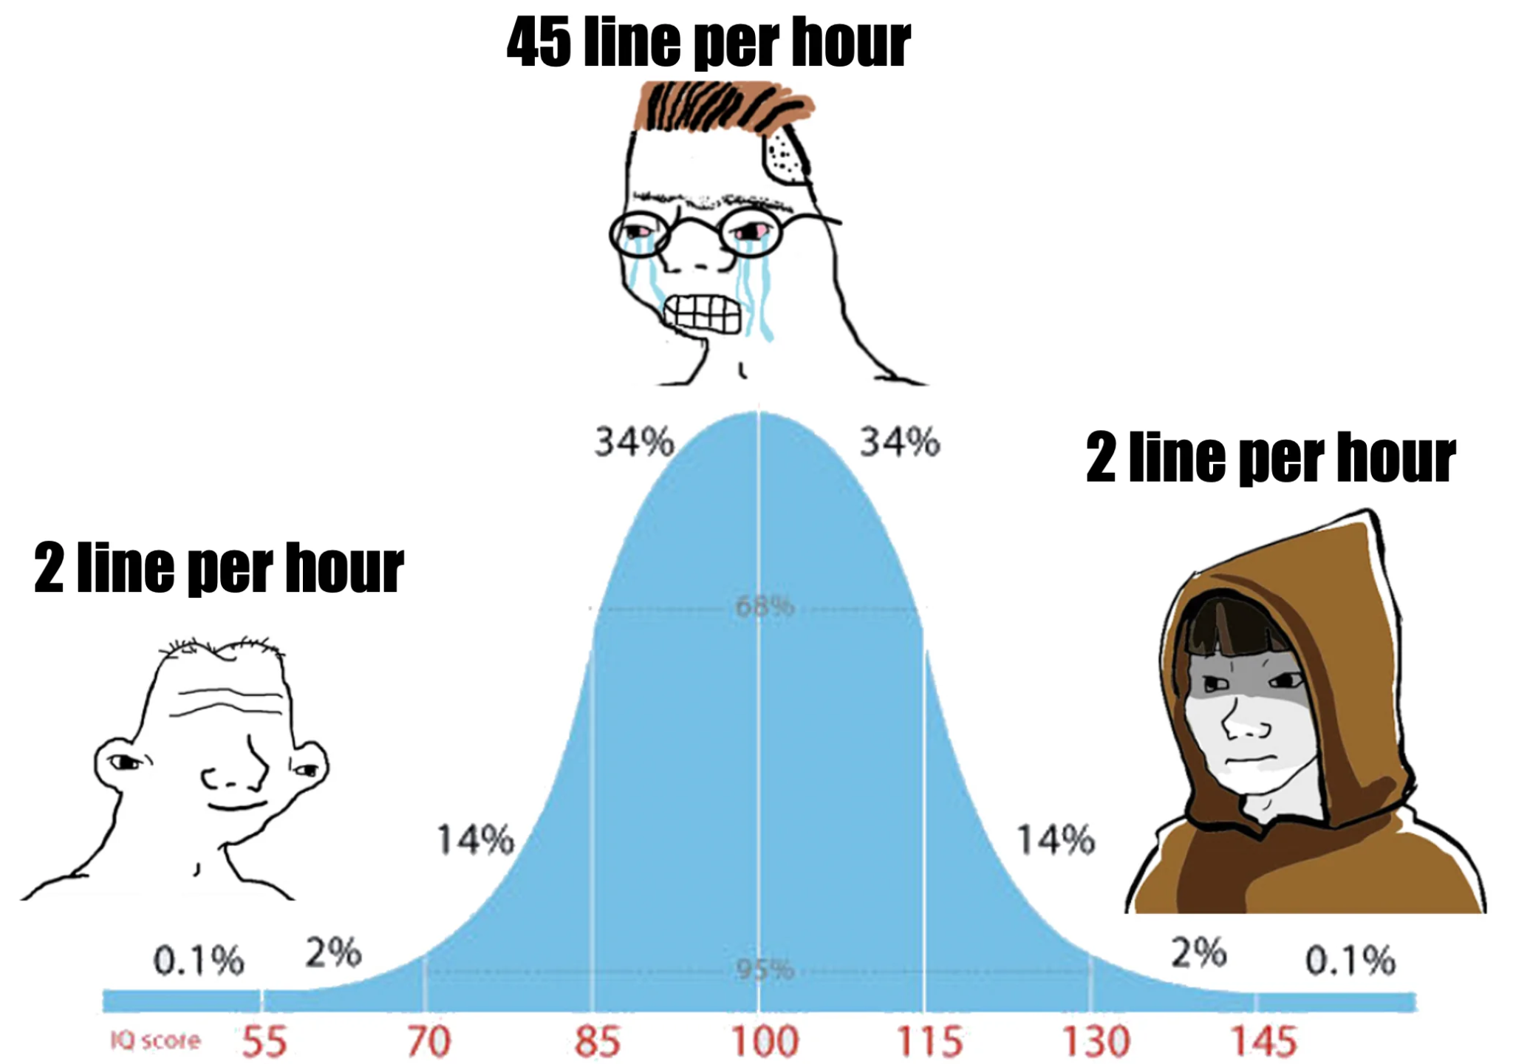
Behavioral changes, Improvements & Optimization
Is the change necessary?
Does the change improve the codebase?
Notes:
Some of the best modifications to the codebase are deletions

Slide 11
Bug Fixes & Rollbacks
Should focus solely on fixing the indicated bug & updating the associated tests
Should not address “other issues”
Increases the size of the PR
This increases difficulty in performing regression test
Be as small and atomic as possible

Slide 12
Refactorings & Large-Scale Changes
Check for correctness & applicability
Limit comments & only flag concerns specific to your code
Notes:
Version bumps in pom.xml

Slide 13
TLDR;
Code review has many benefits, including ensuring code correctness, comprehension & consistency across a codebase
Optimize for the reader
Provide opportunity for critical feedback while remaining professional
Code review is important for knowledge sharing throughout an organization
Automation is critical for scaling the process (pre-commit linters)
The code review itself provides a historical record

